Slide 1




UNIT-III
STRINGS:
    Definition
    Declaration
    Initialization
    Accessing
    String handling functions

Slide 2
String Handling
String is an array of characters(A string is actually a on dimensional array of characters).
String is a sequence of characters that are treated as a single data item and terminated by a null character '\0'.
String Declaration and initialization:
Method 1: char arrayname[ ]={'H', 'E', 'L', 'L', 'O', '\0'};
Method 2: char arrayname[ ]="HELLO";
In the above declaration NULL character (\0) will automatically be inserted at the end of the string.
What is NULL Char “\0”?
'\0' represents the end of the string. It is also referred as String terminator & Null Character.

Slide 3
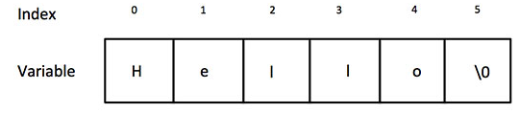
String Handling
#include <stdio.h> void main () { char a[6] = {'H', 'e', 'l', 'l', 'o', '\0'}; printf(" %s", a); }
char a[] = "Hello"
Note: %s format specifier is used for strings input/output

Slide 4
gets() and puts()
gets() and puts()
Functions gets() and puts() are two string functions to take string input from the user and display it respectively.
Note:
Though, gets() and puts() function handle strings, both these functions are defined in "stdio.h" header file.
C supports a large number of string handling functions in the standard library "string.h".

Slide 5
String I/O in C programming
Read & write Strings in C using Printf() and Scanf() functions | Read & Write Strings in C using gets() and puts() functions
#include <stdio.h> #include <string.h> void main() { char a[20]; printf("Enter your name: "); scanf("%s", a); printf("%s", a); } Output: Enter your name: Sanket Sanket | #include <stdio.h> #include <string.h> void main() { char a[20]; puts("Enter your name:"); gets(a); puts(a); } Output: Enter your name: Sanket Sanket

Slide 6
commonly used string handling functions
Function | Work of Function
strlen( ) | computes string's length
strcpy( ) | copies a string to another
strcat( ) | concatenates(joins) two strings
strcmp( ) | compares two strings
strlwr( ) | converts string to lowercase
strupr( ) | converts string to uppercase

Slide 7
1. strlen()
It is used to computes string's length
strlen returns you the length of the string stored in array.
However sizeof returns the total allocated size assigned to the array.
Syntax:
Int var.name = strlen(string or arrayname)

Slide 8
Example of strlen(): #include <stdio.h> #include <string.h> void main() { char str1[20] = "vaishnavtej"; int a=strlen(str1); printf("Length of string str1: %d", a); } Output: Length of string str1: 11

Slide 9
2.strcpy()
It copies the string str2 into string str1, including the end character (terminator char ‘\0’).
Syntax:
strcpy(destination,source)
Or
strcpy(str1,str2)

Slide 10
Example of strcpy()
#include <stdio.h> #include <string.h> void main() { char s1[30] = "sanket"; char s2[30] = "sohel"; /* this function has copied s2 into s1*/ strcpy(s1,s2); printf("s1 = %s", s1); printf("s2 = %s", s2); }

Slide 11
3.stringlwr()
Syntax:
strlwr(string/arrayname )
It will convert string into lowercase
#include<stdio.h> #include<string.h> void main() { char str[ ] = "MAKE YOUR DREAMS COME TRUE"; printf(“Lowercase: %s", strlwr(str) ); } Output: Lowercase: make your dreams come true

Slide 12
4.stringupr()
Syntax:
strupr(string /arrayname)
It will convert string into uppercase
#include<stdio.h> #include<string.h> void main() { char str[ ] = “dreams don’t work unless you take action"; printf("Uppercase: %s", strupr(str) ); } Output: Uppercase: DREAMS DON’T WORK UNLESS YOU TAKE ACTION

Slide 13
5.strcat()
It concatenates two strings and returns the concatenated string.
Right side string will be added to at the end of the left side string.
It concatenates n characters of str2 to string str1. A terminator char (‘\0’) will always be appended at the end of the concatenated string.
Syntax:
strcat(string1,string2)

Slide 14
5.strcat()
#include<stdio.h> #include <string.h> Void main() { char s1[30] = “Sanket"; char s2[10] = “Sahadev"; strcat(s1,s2); printf("after concatenation: %s",s1); } Output: after concatenation: SanketSahadev | #include <stdio.h> #include <string.h> void main() { char s1[10] = "Sanket"; char s2[10] = "Sahadev"; strncat(s1,s2, 4); //it take first 3 characters from second string to first string printf("Concatenation : %s", s1); } Output: Concatenation : SanketSaha

Slide 15
6. strcmp ()
It compares the two strings and returns an integer value.
If string1 < string2 then it would result in a negative value.
If string1 > string2 then it would return positive value.
If string1 == string2 then you would get 0(zero) when you use this function for compare strings.
Syntax:
strcmp(string1,string2 )

Slide 16
6. strcmp ()
#include <stdio.h> #include <string.h> void main() { char s1[20] = “Geetham"; char s2[20] = “geetham"; if (strcmp(s1, s2) ==0) { printf("string 1 and string 2 are equal"); } else { printf("string 1 and 2 are different } } Output: string 1 and 2 are different

Slide 17
7. strrev()
This function is used to reverses a given string.
Syntax:
strrev(string/arrayname );

Slide 18
7. strrev()
#include<stdio.h> #include<string.h> void main() { char a[30] = “hello”; printf(“String before reverse : %s\n”, a); printf(“String after reverse : %s ”, strrev(a) ); } Output: String before reverse : hello String after reverse : olleh

Slide 19
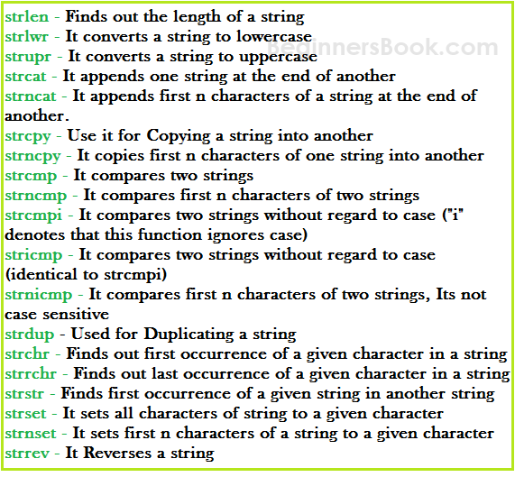
Other String functions

Slide 20

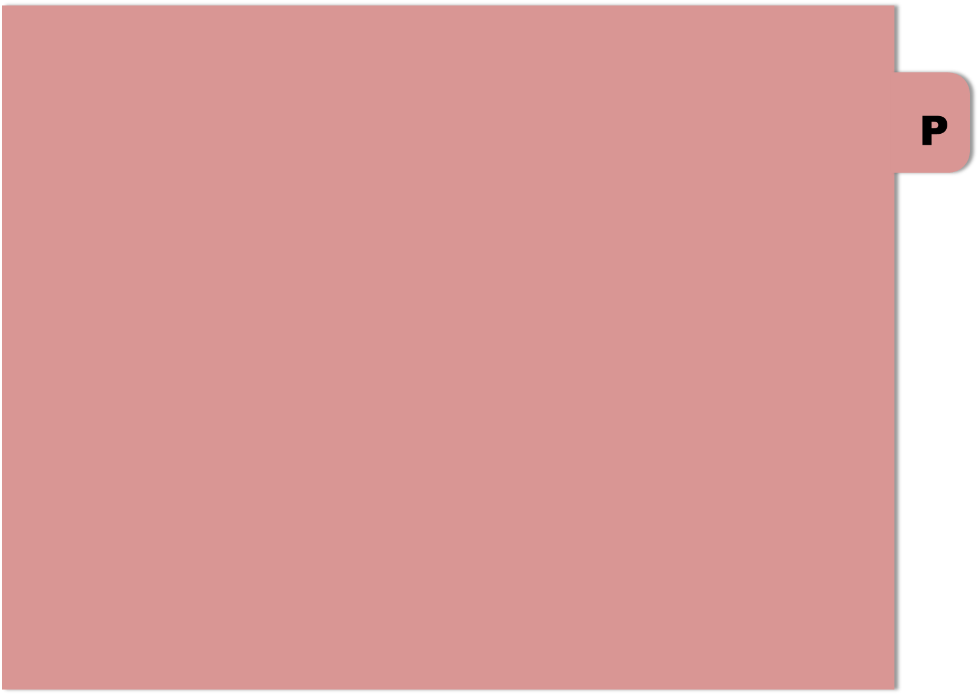

THANK YOU

